Slide 1


BREAST
CANCER
SURVIVAL
ANALYSIS
Emily Bates
Bella Lin
Notes:
Hello, Im ...
for our project, we would like to do survival analysis on breast cancer patients.

Slide 2

RESEARCH QUESTION
AND TECHNIQUES
To understand the factors influencing survival rates among breast cancer patients.
We will perform survival analysis, utilize Kaplan-Meier estimator, log-rank test, and survival curves.
Notes:
Our research question is to understand the factors influencing survival rates among breast cancer patients.
We will perform survival analysis, and utilize the Kaplan-Meier estimator, to analyze the time until a death occurs. This technique accounts for censoring, where some patients may be lost to follow-up or still alive at the end of the study period.
We will also examine the log-rank test results to assess the overall effect of age groups, hormonal therapy, and tumor grade on survival. Additionally, we will focus on the survival curves to compare survival probabilities.

Slide 3
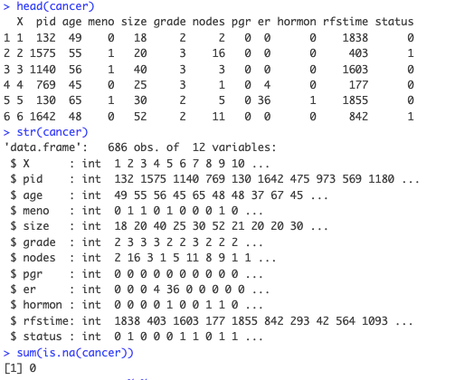
OUR DATASET
The data set contains patient records from a 1984-1989 trial conducted by the German Breast Cancer Study Group of 686 patients with complete data for the prognostic variables.
x - patient number
pid - patient ID number
age - age, years
meno - menopausal status (0= premenopausal, 1= postmenopausal)
size - tumor size, mm
grade - tumor grade
nodes - number of positive lymph nodes
pgr - progesterone receptors (fmol/l)
er - estrogen receptors (fmol/l)
hormon - hormonal therapy, 0= no, 1= yes
rfstime - recurrence free survival time; days to first of recurrence, death or last follow-up
status - 0= alive without recurrence, 1= recurrence or death
Source: https://www.kaggle.com/datasets/utkarshx27/breast-cancer-dataset-used-royston-and-altman
Notes:
Here is the snippet of our dataset, The data set contains patient records from a 1984-1989 trial conducted by the German Breast Cancer Study Group of 686 patients with complete data for the prognostic variables, which are listed on the left. And there are no missing values in our dataset.

Slide 4
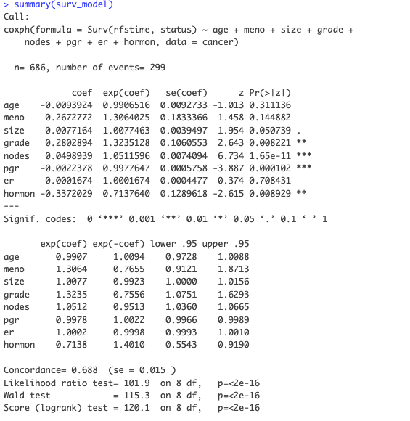
FACTORS INFLUENCING SURVIVAL RATES AMONG BREAST CANCER PATIENTS
Fit an initial survival model using Cox proportional hazards regression with all variables as predictors, excluding patient number and ID.
Significant predictors are: age, tumor grade, number of positive lymph nodes, progesterone receptors, and hormonal therapy.
We will focus on the impact of age groups, tumor grade, and hormonal therapy.
Notes:
To start, we would like to identify factors that can influence survival rates among breast cancer patients. So we fit an initial survival model using Cox proportional hazards regression with all variables as predictors, excluding patient number and ID.
The model identifies several significant predictors of recurrence-free survival in breast cancer patients,
including age, tumor grade, number of positive lymph nodes, progesterone receptors, and hormonal therapy.
Then, we want to investigate the impact of age groups, tumor grade, and hormonal therapy on survival outcomes.

Slide 5
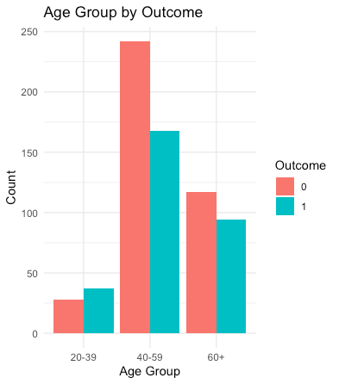
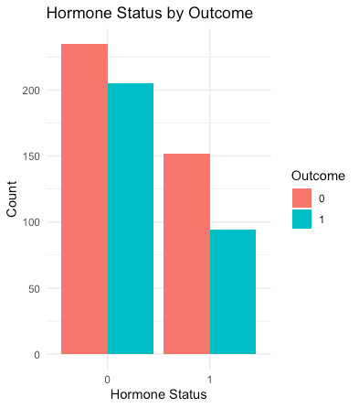
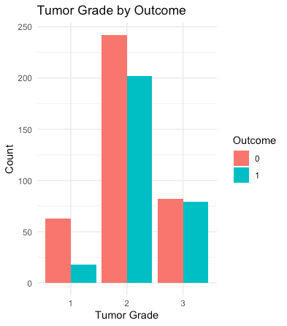
ADDITIONAL DATA EXPLORATION
Notes:
Emily: Before we jump into survival analysis, let's take a look at outcomes for the three variables we'll be analyzing, which are age group, hormone status, and tumor grade. By taking an initial look at each, we can see those in the 20-39 age group have more instances of reoccurrence or death than otherwise (which is different than the other groups). When looking at hormone status we see that overall fewer people did hormone therapy than did not, with both groups having more people without reoccurrence or death. And finally when looking at tumor grade, we can generally see that the greater the grade, the smaller the gap is between amount of people with no event, and those who had a reoccurrence or died.

Slide 6
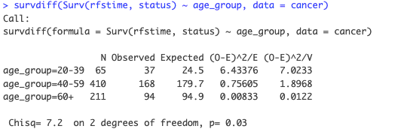
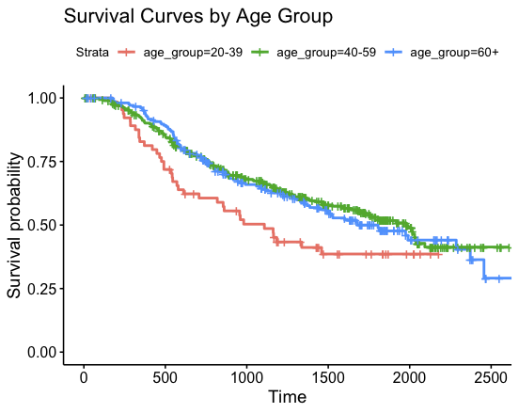
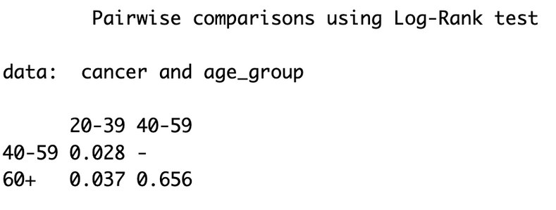
SURVIVAL ANALYSIS BY AGE GROUP
Log-rank Test Result
Survival Curves
Notes:
First we will look at Survival Analysis by age group.
The log-rank test has a P-value of 0.03, which shows that there is at least one difference between the three survival curves of different age groups.
To explore further, we can see the survival curves and perform a pairwise comparison.
When we compare the age groups 20-39 and 40-59 we see that the p-value is 0.028 which indicates that we can reject the null hypothesis that there isn't a difference between the groups.
In comparing the age groups 20-39 and 60+, we see that the p-value is 0.037, meaning we can also reject the null hypothesis that there isn't a difference between these two age groups. The p-value of 0.656 between age group 40-59 and 60+ indicates that we cannot reject the null hypothesis. So there isn't
a difference between these two age groups.
Which is interesting. When looking at the survival curves, we see that at the last measurement where all groups are present, the 20-39 age group is the least probable age group to survive.

Slide 7
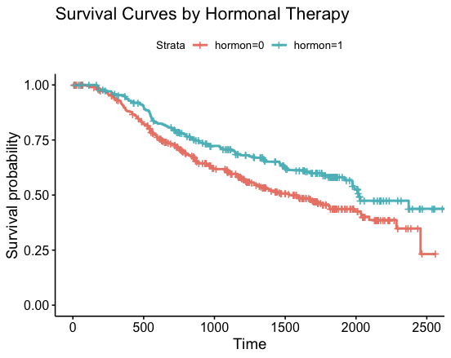
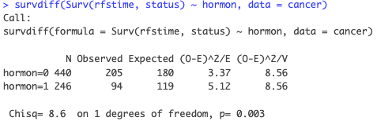
SURVIVAL ANALYSIS BY HORMONAL THERAPY
Log-rank Test Result
Survival Curves
Notes:
Now let's turn to survival analysis by hormonal therapy. There are only two groups here: those who did the therapy and those who did not.
The log-rank test has a P-value of 0.003, showing that there is a difference between those who did hormone therapy and those who did not. According to the survival curves shown, we can see that people who received hormonal therapy have a higher chance of survival.

Slide 8
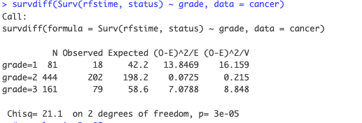
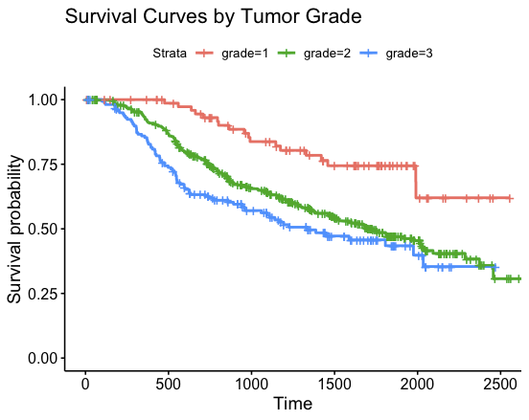
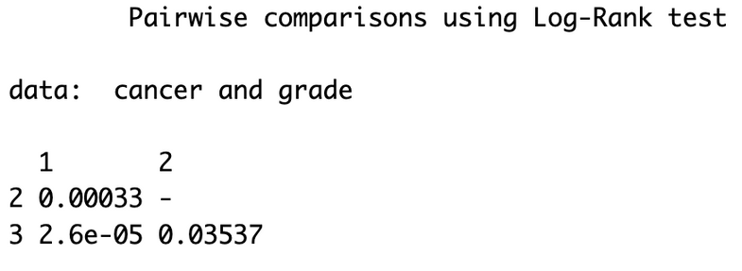
SURVIVAL ANALYSIS BY TUMOR GRADE
Log-rank Test Result
Survival Curves
Notes:
Next we examine survival by tumor grade, of which there are three groups.
Looking at the log-rank test result, the p-value is less than 0.05, meaning there is a significant overall effect of tumor grade on survival. When looking at the pairwise comparison test, each combination of groups has a p-value less than 0.05, meaning we can reject null hypotheses that there isn't a difference between each grouping.
Overall when looking at the survival curves, we can see that the smaller the tumor grade, the higher survival probability.

Slide 9

CONCLUSION
Our analysis reveals significant differences in survival rates between age groups, different tumor grades, and among patients receiving hormonal therapy versus those who don't.
Assumption: the censoring mechanism is non-informative, meaning that the probability of being censored is unrelated to the survival time.
Notes:
Our analysis reveals significant differences in survival rates between age groups, different tumor grades, and among patients receiving hormonal therapy versus those who don't.
We assume that the censoring mechanism is non-informative, meaning that the probability of being censored is unrelated to the survival time.
this is the end of our presentation, thank you for listening.

